Slide 1
Amichroma 2k22

Slide 2
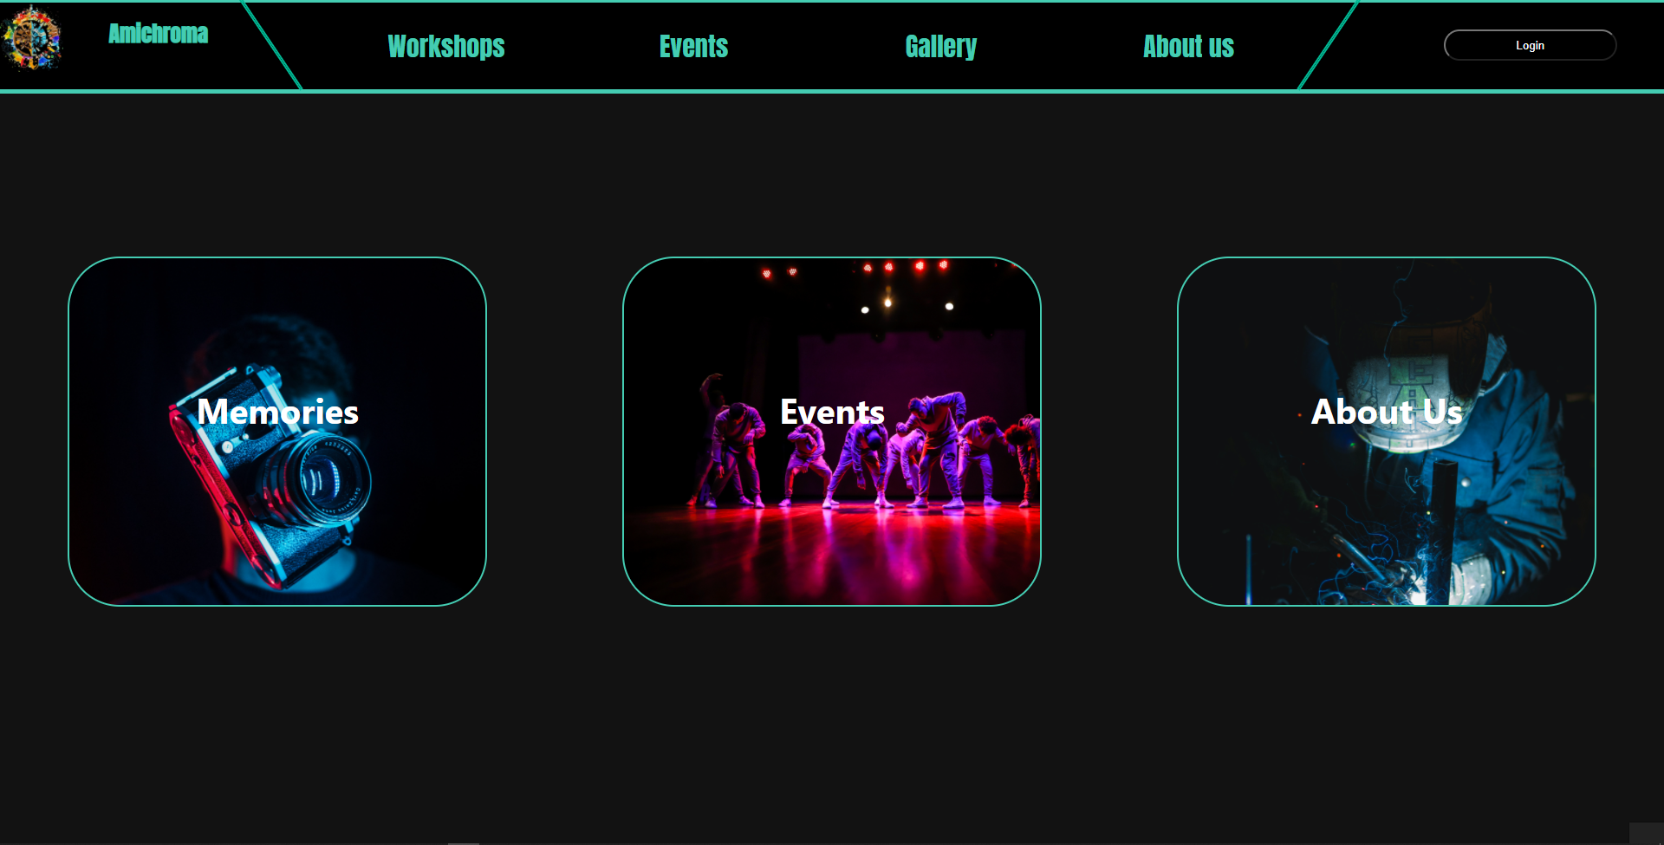
Home Page

Slide 3
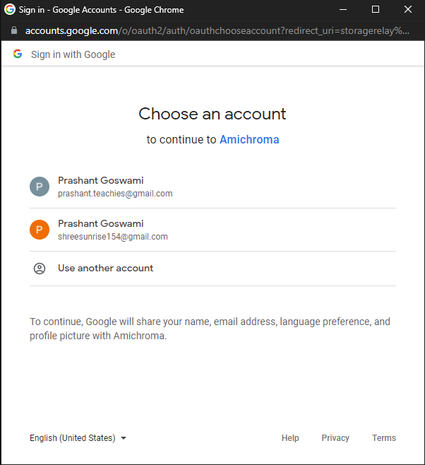
Using Google Oauth 2.0
When you click on login button
Login using gmail account

Slide 4
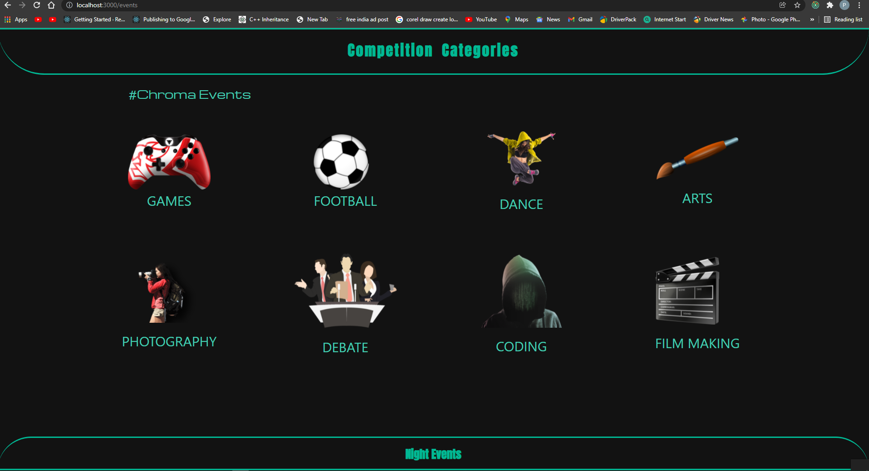
Selection of Event
On clicking the event nav button
Event Page

Slide 5
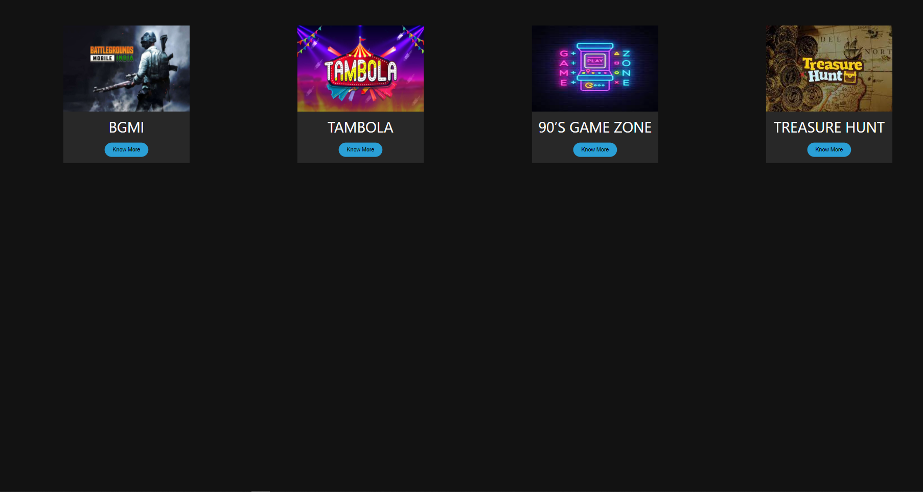
On clicking any category
Let assume we click on Game
OutScreen Every Game Event

Slide 6
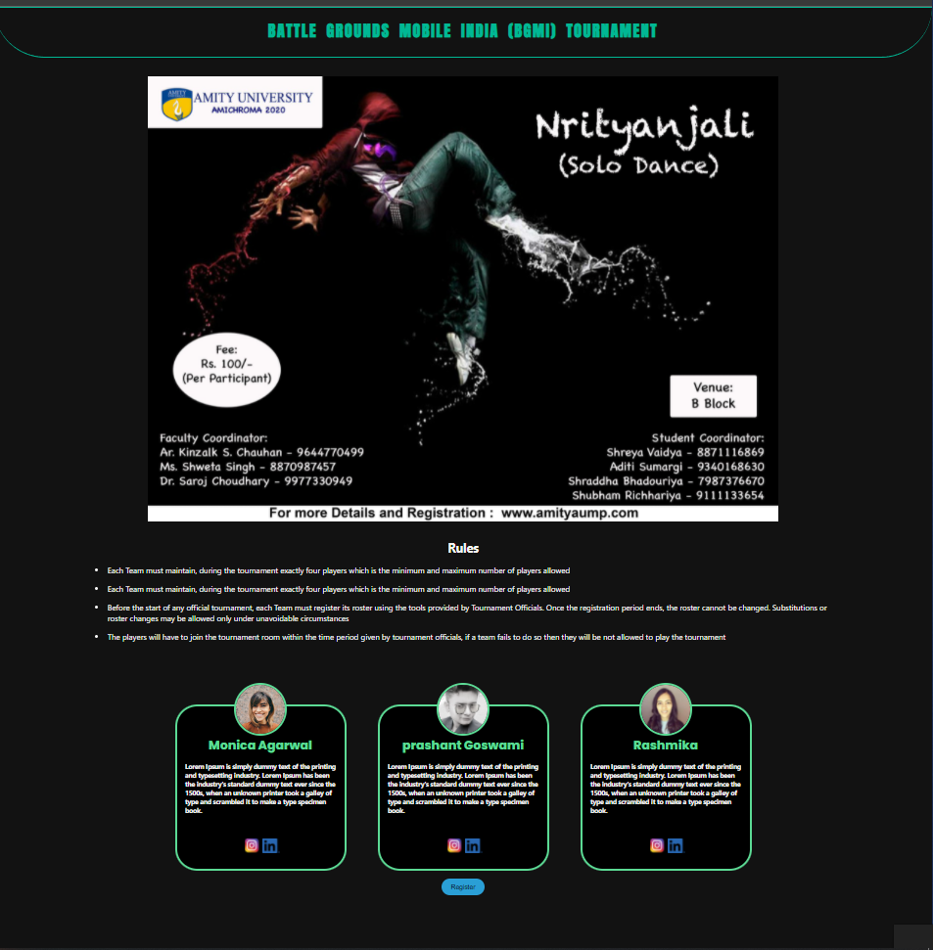
Event Slection
Select your Event let say we select bgmi by clicking on know more
All details about the Event

Slide 7
Know More Page
Full Event Title
Poster Related to the event
Rules and Regulation
Coordinator experience
Register Button

Slide 8
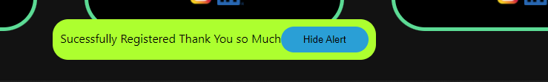
Registration {individual event}
On clicking Register
Alert will be show if you are successfully Registered
User Data collection
Using Sql database for collection of data
Table Registered_Student
fields
GoogleId=Unique_mail_id
Name=gmail_Acc_name;
Gmail=gmail id;
Condition 1:User need to login No registration without login

Slide 9
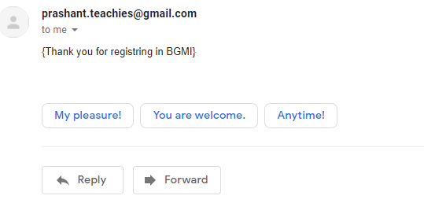
On Successfully Registration
A conformation Mail will be Delievere to The mail iD of Sutdent
With Useful Details like
Whatsapp_group_link
Schedule

Slide 10

On Group Events
After SuccessFully Register
Create Team
A uniqueId is Provided to Student As team_id
After that member can join using join team button by entering the id

Slide 11

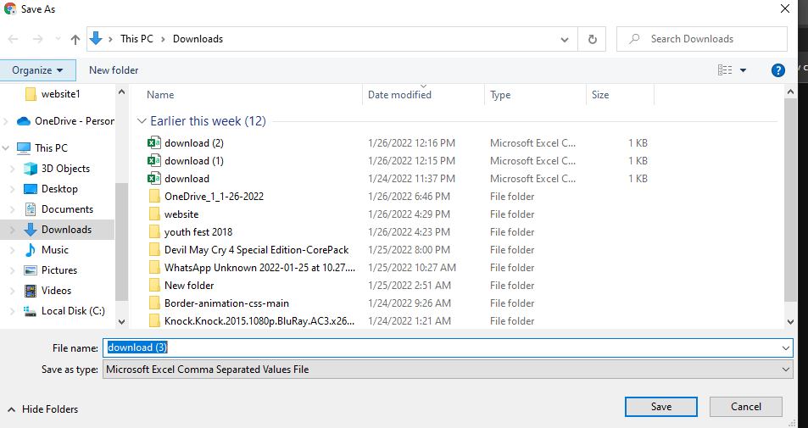

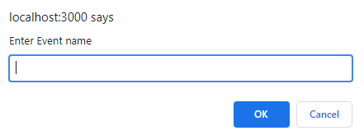
Admin Controls
Get All Registered User Details In A excel Sheet
Get All Registered User of Particular Event In A excel Sheet
*Admin will be set by default

Slide 12
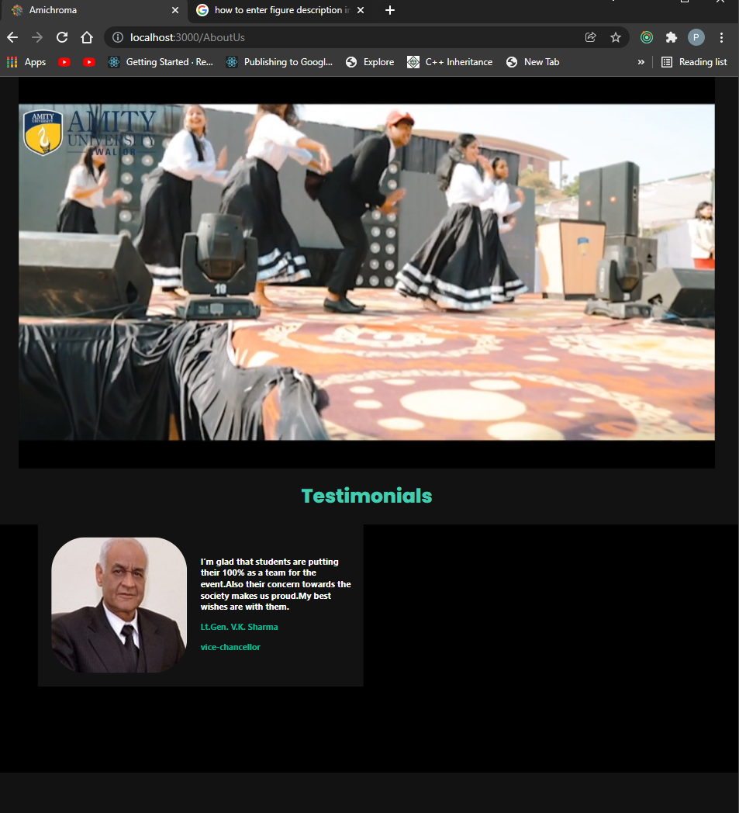
About Us
Page With Messages BY Faculty
About the Team Member

Slide 13
Tech
FrontEnd
React
Css
Html
Backend
Node js
Express
Database
SQl
security
JWT token
Google Authentication
Middlewares
Website with fully Responsiveness high Security

